Slide 1

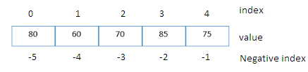
List Manipulation
It is a collections of items and each item has its own index value.
Index of first item is 0 and the last item is n-1.Here n is number of items in a list.
Indexing of list

Slide 2
List Manipulation
Creating a list
Lists are enclosed in square brackets [ ] and each item is separated by a comma.
e.g.
list1 = [‘English', ‘Hindi', 1997, 2000];
list2 = [11, 22, 33, 44, 55 ];
list3 = ["a", "b", "c", "d"];

Slide 3
List Manipulation
Access Items From A List
List items can be accessed using its index position.
e.g.
list =[3,5,9] print(list[0]) print(list[1]) print(list[2])
print('Negative indexing')
print(list[-1])
print(list[-2])
print(list[-3])
3
5
9
Negative indexing 9
5
3
output

Slide 4
List Manipulation
Iterating Through A List
List elements can be accessed using looping statement.
e.g.
list =[3,5,9]
for i in range(0, len(list)): print(list[i])
Output 3
5
9

Slide 5
List Manipulation
Slicing of A List
List elements can be accessed in subparts.
e.g.
list =['I','N','D','I','A']
print(list[0:3])
print(list[3:])
print(list[:])
Output ['I', 'N', 'D'] ['I', 'A']
['I', 'N', 'D', 'I', 'A']

Slide 6
List Manipulation
Updating Lists
We can update single or multiple elements of lists by giving the slice on the left-hand side of the assignment operator.
e.g.
list = ['English', 'Hindi', 1997, 2000]
print ("Value available at index 2 : ", list[2])
list[2:3] = 2001,2002 #list[2]=2001 for single item update print ("New value available at index 2 : ", list[2])
print ("New value available at index 3 : ", list[3])
Output
('Value available at index 2 : ', 1997) ('New value available at index 2 : ', 2001) ('New value available at index 3 : ', 2002)

Slide 7
List Manipulation
Add Item to A List
append() method is used to add an Item to a List.
e.g. list=[1,2]
print('list before append', list) list.append(3)
print('list after append', list)
Output
('list before append', [1, 2])
('list after append', [1, 2, 3])
NOTE :- extend() method can be used to add multiple item at a time in list.eg - list.extend([3,4])

Slide 8
List Manipulation
Add Item to A List
append() method is used to add an Item to a List.
e.g. list=[1,2]
print('list before append', list) list.append(3)
print('list after append', list)
Output
('list before append', [1, 2])
('list after append', [1, 2, 3])
NOTE :- extend() method can be used to add multiple item at a time in list.eg - list.extend([3,4])

Slide 9

List Manipulation
Add Two Lists
e.g.
list = [1,2]
list2 = [3,4]
list3 = list + list2 print(list3)
OUTPUT [1,2,3,4]

Slide 10
List Manipulation
Delete Item From A List e.g.
list=[1,2,3]
print('list before delete', list) del list [1]
print('list after delete', list)
Output
('list before delete', [1, 2, 3])
('list after delete', [1, 3])
e.g.
del list[0:2] # delete first two items del list # delete entire list

Slide 11
List Manipulation
Basic List Operations
Python Expression | Results | Description
len([4, 2, 3]) | 3 | Length
[4, 2, 3] + [1, 5, 6] | [4, 2, 3, 1, 5, 6] | Concatenation
[‘cs!'] * 4 | ['cs!', 'cs!', 'cs!', 'cs!'] | Repetition
3 in [4, 2, 3] | True | Membership
for x in [4,2,3] : print (x,end = ' ') | 4 2 3 | Iteration

Slide 12
List Manipulation
Important methods and functions of List
Function | Description
list.append() | Add an Item at end of a list
list.extend() | Add multiple Items at end of a list
list.insert() | insert an Item at a defined index
list.remove() | remove an Item from a list
del list[index] | Delete an Item from a list
list.clear() | empty all the list
list.pop() | Remove an Item at a defined index
list.index() | Return index of first matched item
list.sort() | Sort the items of a list in ascending or descending order
list.reverse() | Reverse the items of a list
len(list) | Return total length of the list.
max(list) | Return item with maximum value in the list.
min(list) | Return item with min value in the list.
list(seq) | Converts a tuple, string, set, dictionary into list.

Slide 13
List Manipulation
Some Programs on List
* find the largest number in a list
#Using sort a=[]
n=int(input("Enter number of elements:")) for i in range(1,n+1):
b=int(input("Enter element:")) a.append(b)
a.sort()
print("Largest element is:",a[n-1])
#using function definition
def max_num_in_list( list ): max = list[ 0 ]
for a in list: if a > max:
max = a return max
list1, list2 = [123, 'xyz', 'zara', 'abc'], [456, 700, 200] print "Max value element : ", max(list1)
print "Max value element : ", max(list2) Output
Max value element : zara Max value element : 700
print(max_num_in_list([1, 2, -8, 0]))

Slide 14
List Manipulation
Some Programs on List
* find the mean of a list
def Average(lst):
return sum(lst) / len(lst)
# Driver Code
lst = [15, 9, 55, 41, 35, 20, 62, 49]
average = Average(lst)
# Printing average of the list
print("Average of the list =", round(average, 2))
Output
Average of the list = 35.75
Note : The inbuilt function mean() can be used to calculate the mean(
average ) of the list.e.g. mean(list)

Slide 15
List Manipulation
Some Programs on List
* Linear Search
list_of_elements = [4, 2, 8, 9, 3, 7]
x = int(input("Enter number to search: "))
found = False
for i in range(len(list_of_elements)):
if(list_of_elements[i] == x):
found = True
print("%d found at %dth position"%(x,i)) break
if(found == False):
print("%d is not in list"%x)

Slide 16
List Manipulation
Some Programs on List
* Frequency of an element in list import collections
my_list = [101,101,101,101,201,201,201,201]
print("Original List : ",my_list)
ctr = collections.Counter(my_list) print("Frequency of the elements in the List : ",ctr)
OUTPUT
Original List : [101, 101,101, 101, 201, 201, 201, 201]
Frequency of the elements in the List : Counter({101: 4, 201:4})
NOTE :SAME CAN BE DONE USING COUNT FUNCTION.E.G. lst.count(x)

Slide 17

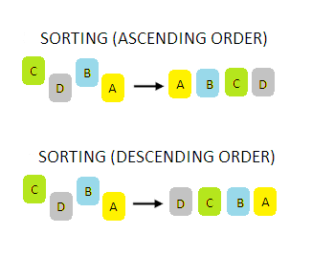
SORTING
Sorting is process of arranging items systematically ,according to a comparison operator applied on the elements.

Slide 18
SORTING
There are various softing algorithms .Two of them are-
Bubble Sort
Insertion Sort

Slide 19
SORTING
1. Bubble Sort-
It is one of the simplest sorting algorithms. The two adjacent elements of a list are checked and swapped if they are in wrong order and this process is repeated until the whole list elements are sorted. The steps of performing a bubble sort are:
Compare the first and the second element of the list
and swap them if they are in wrong order.
Compare the second and the third element of the list and swap them if they are in wrong order.
Proceed till the last element of the list in a similar
fashion.
Repeat all of the above steps until the list is sorted.

Slide 20

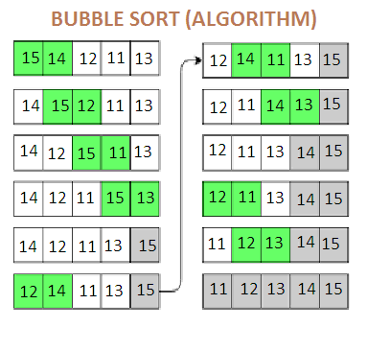
SORTING
1. Bubble Sort-

Slide 21
SORTING
1. Bubble Sort-Python Program
a = [6, 19, 1, 15, 11, 12, 14]
#repeating loop len(a)(number of elements) number of times
for j in range(len(a)): #initially swapped is false swapped = False
i = 0
while i<len(a)-1:
#comparing the adjacent elements
if a[i]>a[i+1]: #swapping
a[i],a[i+1] = a[i+1],a[i]
#Changing the value of swapped swapped = True
i = i+1
#if swapped is false then the list is sorted #we can stop the loop
if swapped == False: break
print (a)

Slide 22

SORTING
1. Bubble Sort- No of Operation in sorting
In Bubble Sort, n-1 comparisons will be done in the 1st pass, n-2 in 2nd pass, n-3 in 3rd pass and so on. So the total number of comparisons will be as follows-
Hence time complexity of Bubble Sort is O(n2).
The main advantage of Bubble Sort is the simplicity of the algorithm.
The space complexity for Bubble Sort is O(1), because only a single additional memory space is required .
Also, the best case time complexity will be O(n),only when the list is already sorted.
Following are the Time and Space complexity for the Bubble Sort algorithm. Worst Case Time Complexity [ Big-O ]: O(n2)
Best Case Time Complexity [Big-omega]: O(n) Average Time Complexity [Big-theta]: O(n2) Space Complexity: O(1)

Slide 23

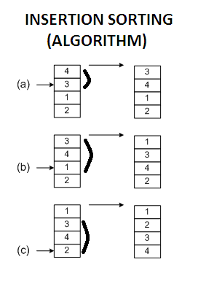
SORTING
2. Insertion Sort –
Insertion sort is a simple sorting algorithm .It is just similar the way we sort playing cards in our hands.

Slide 24
SORTING
2. Insertion Sort – Python Program list = [19, 12, 13, 15, 6]
for i in range(1, len(list)):
key = list[i]
# Move elements of list[0..i-1], that are # greater than key, to one position next # of their current position
j = i-1
while j >=0 and key < list[j] : list[j+1] = list[j]
j -= 1
list[j+1] = key
print ("Sorted listay is:") for i in range(len(list)):
print ("%d" %list[i])

Slide 25
SORTING
2. Insertion Sort – No of Operation in sorting
In insertion sort ,to insert the last element at most n-1 comparisons and n-1 movements needed.
To insert the n-1st element n-2 comparisons and n-2 movements needed.
….
To insert the 2nd element 1 comparison and one
movement needed.
Its sum up is given below:
2* (1 + 2 + 3 +… N - 1) = 2 * (N - 1)* N / 2 = (N-1)*N = Θ (N²)
If the greater part of the array is sorted, the complexity is
almost O(N)
The average complexity is proved to be = Θ (N²)

